Slide 1
Analysis module and REPOT subsystem

Slide 2
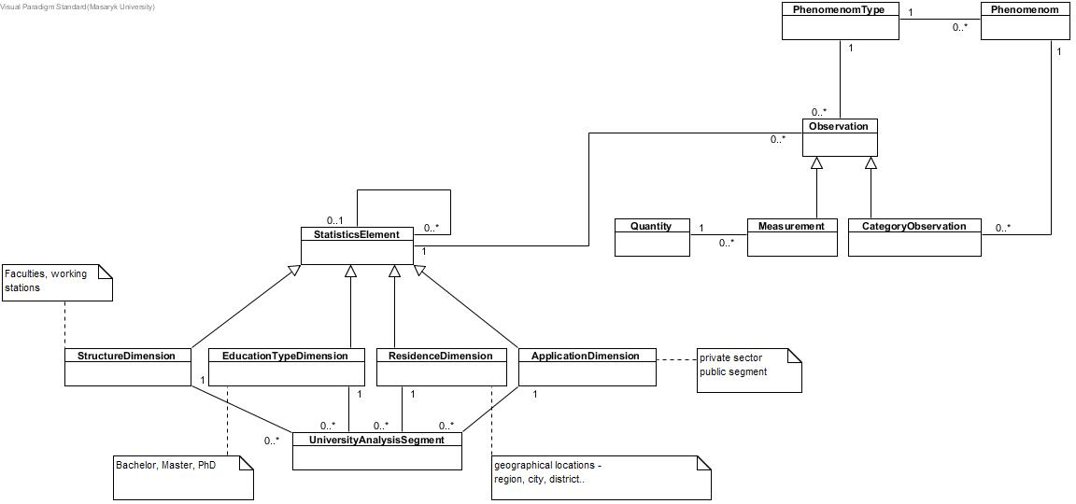
Analysis module

Slide 3
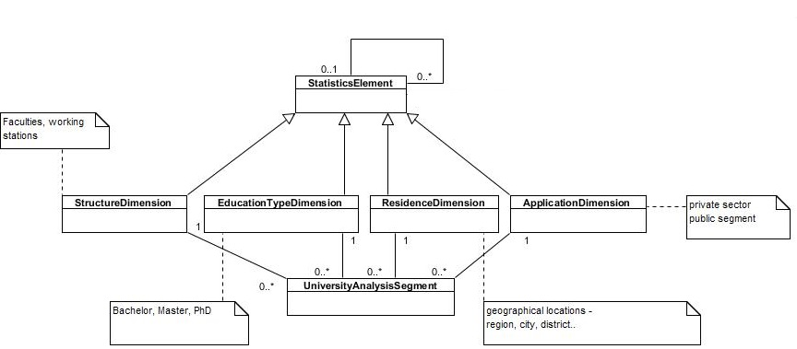
Enterprise segment

Slide 4
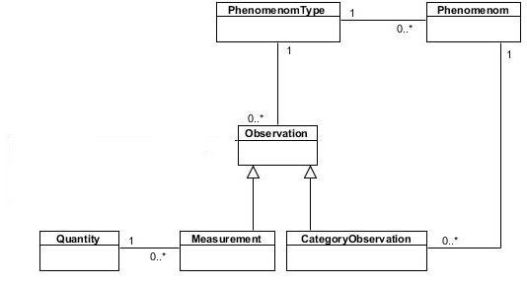
Observation

Slide 5
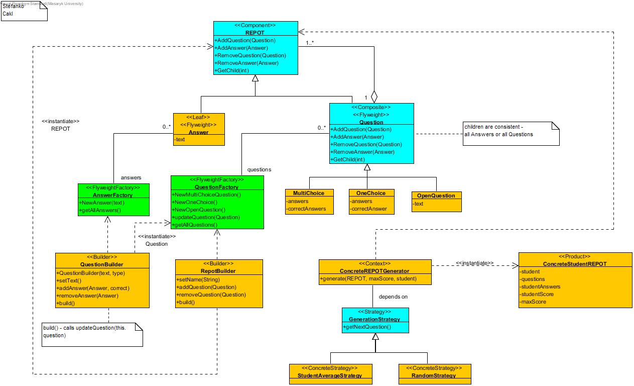
REPOT class diagram

Slide 6
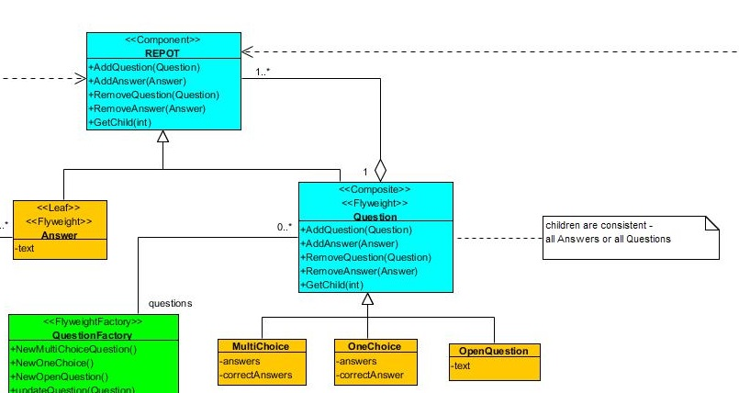
Composite

Slide 7
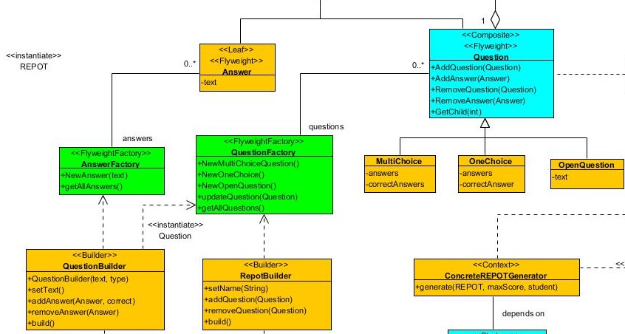
Flyweight and Builder

Slide 8
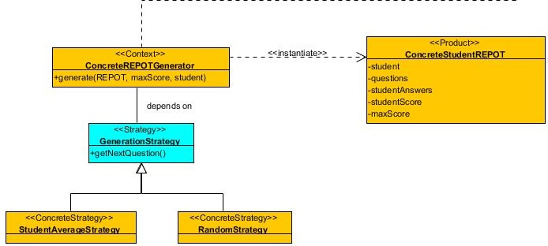
Strategy

